Slide 1
Welcome To My Presentation
Team Member :
  Md Shahinur
  Md. Mizanur Rahman

Slide 2
Project Name
GSM Based Home Security System using PIR Sensor and Arduino

Slide 3
Introduction :
In our day-to-day life crime is increasing rapidly, so one of the important things is the security of our home, office, and shop from thieves/burglars. There are different types of home security systems available in the market including several security features like fire, LPG, electronic door lock, heat, smoke, temperature, etc.
In this project tutorial, we will be going to design a Home Security System using PIR sensor and GSM module which detects intruders and informs the owner. This system/device detects thieves/burglars when they try to enter the house and informs the owner by sending text messages on her/his phone.

Slide 4
Project Concept :
This GSM Based Home Security System project has been implemented on a very simple concept and it’s very easy to build. The fundamental components of this project are the PIR sensor, Arduino, SIM800L GSM Module, LED, and Buzzer.
PIR sensor detects the motion of surrounding objects by sensing the difference in infrared or radiant heat levels emitted by that objects. It produces high output by detecting the movement of any objects or human body in front of it. Here it is used to detect thieves/burglars (any human beings). When someone comes in front of the sensor, it detects motion and provides a high output voltage. This output voltage goes to the Arduino. Here we will use Arduino UNO which is the main microcontroller of this project, it controls the whole system. When the Arduino read this high output voltage, then it sends commands to the GSM module for sending a Text Message/SMS to a specific user’s Mobile number. The LED and Buzzer are working as warning indicators, which alert us when someone tries to enter the house.

Slide 5
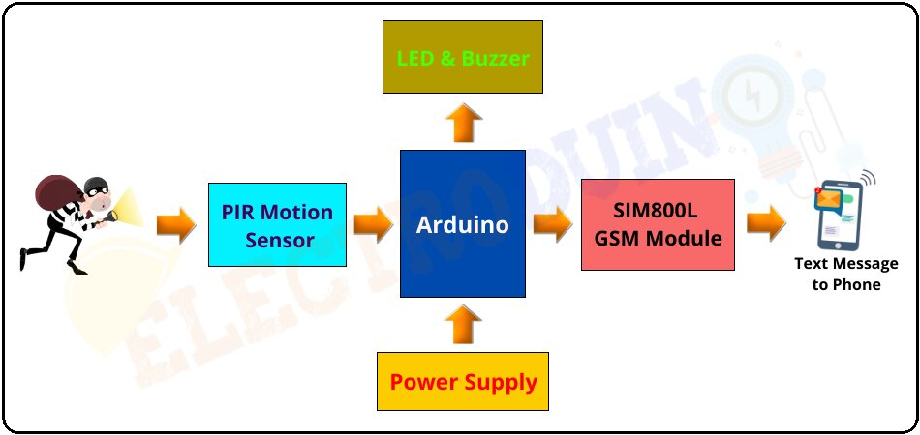
Block Diagram of GSM SIM800L Based Home Security System

Slide 6
Components Required :
Components Name | Quantity
Arduino Uno | 1
PIR Motion Sensor | 1
SIM800L GSM Module | 1
Red LED (D1) | 1
Buzzer (B1) | 1
1000µf 50V Capacitor | 1
Slide Switch (SW1) | 1
9V Battery with Battery connector | 1
4.1V Power Supply | 1
PCB Zero board | 1
Connecting wires | As required in the circuit diagram

Slide 7
Tools Required
Tools Name | Quantity
Soldering Iron | 1
Soldering wire | 1
Soldering flux | 1
Soldering stand | 1
Multimeter | 1
Desoldering pump | 1
Wirecutter | 1

Slide 8
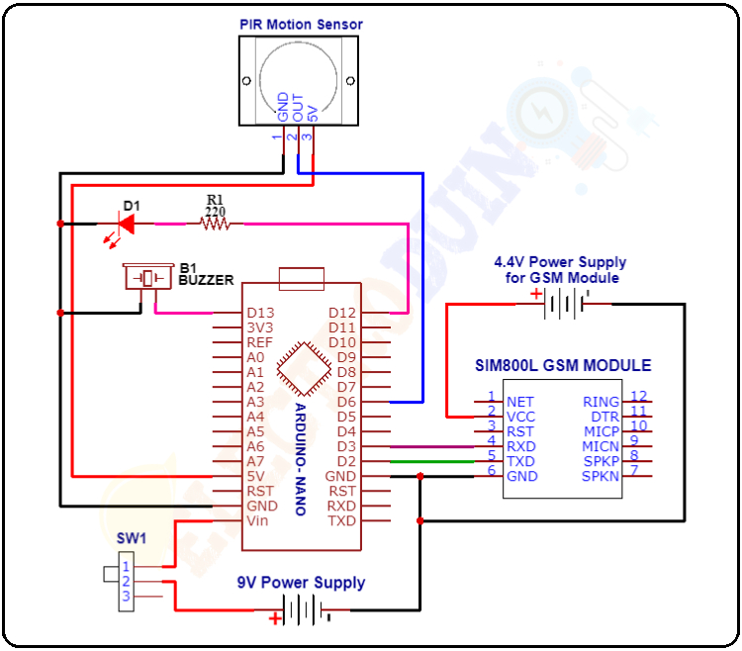
Circuit/Schematic Diagram of GSM SIM800L Based Home Security System

Slide 9
Circuit Wiring :
Components Name | Components Pin | Arduino Pin
PIR Motion Sensor | GND OUT VCC | GND D6 5VJ
SIM800L GSM Module | VCC RXD TXD GND | The positive terminal of 4.1v External Power Supply D3 D2 The negative terminal of 4.1V External Power Supply and Arduino GND
Buzzer (B1) | Positive terminal Negative terminal | D13 GND
LED (D1) | Positive terminal Negative terminal | D12 GND
9V Power Supply | Positive terminal Negative terminal | Vin GND

Slide 10
Working Principle of GSM Based Home Security System using Arduino :
After connecting all components according to the circuit diagram and uploading the code to the Arduino board. When the input power supply is applied to the circuit, then the Arduino starts working step by step according to the code/Program.
First of all, the Arduino makes the connection to the Network with help of the SIM800L GSM Module.
At the same time, The PIR sensor requires a “warm-up” time of 20 to 60 seconds to proper operation. This time is required because the PIR sensor has a settling time duration, during this time it calibrates according to the environment and stabilizes the infrared detector.
Remember that, during this time a small motion in front of the sensor can create an error in calibration and the PIR sensor may not produce a reliable output. So, try to avoid very little movement in front of the sensor at the “warm-up” time.
We need to install the GSM Based Home Security System circuit/device at the entrance of the house, where have a chance to enter the thieves/burglars.
When someone comes in the detection range of the PIR Motion Sensor, then it detects motion and produces a High (5v) output signal from its output pin. The Arduino reads this high output signal and it realizes someone has come in front of the sensor. Now, the Arduino communicates with the SIM800L GSM module via serial communication to send Text Messages to the owner’s mobile number. The mobile number has pre-programmed in code, you can change it in code.
At the same time, the Red LED and buzzer also turn on, these warn the owner that someone (thieves/burglars) has come in front of the Door (Sensor).

